Slide 1
Bima Bharosa API Automation

Slide 2
Problem Statement
Problem Statement
Comparative statement
Comparison Table
Tools Used
Team Structure
Application Flow-Register Complaints
Application Flow-Update Complaints
Framework Structure
Project File Structure
Summary of Test Cases
Project Plan
Extent Report structure
Future scope

Slide 3
Problem Statement
The Bima Bharosa portal for insurance policyholders, relies on manual testing processes. as the number of users and complaints increases, the manual testing approach becomes increasingly inefficient, time-consuming and inclined to human errors, leading to potential defects and quality issues.
The portal handles a vast amount of user data, insurance policies, and complaint details. Manually verifying the accuracy and integrity of data across multiple scenarios and test cases is a troubling task, increasing the risk of data-related defects
To overcome manual API testing issues we using Rest Assured into the API automation framework, allowing for efficient testing with multiple data sets and scenarios, ensuring accuracy across various complaint types and insurance policies.
For Bima Bharosa API automation covers modules register complaint and update complaint and all it’s functionalities.

Slide 4
Comparative Statement-
Step | Manual API testing | Automation API Testing
1. Preparation | Identify test scenarios based on requirements. | Identify test scenarios and prioritize them.
2. Test Execution | Manually send API requests using tools or scripts and Validate responses against expected results. | Write test scripts to automate API requests and responses. Develop assertions to validate responses automatically.
3.Regression Testing | Repeat test cases for regression testing after code changes. verify that previous functionalities still work as expected. | Possible to integrate automation tests into Continuous Integration/Continuous Deployment (CI/CD) pipelines. trigger automated tests as part of the build and deployment process.
4.Adaptation | Adjust test cases based on changes in requirements or API behavior. | Maintain test scripts and frameworks. Update scripts to accommodate changes in API or requirements.

Slide 5
Comparison Table
Modules | Time taken by manually in sec | Time taken in automation in sec | Time saved | % of time saved
Register Complaint | 6560 | 14 | 6546 | 99.78
Update Complaint | 8500 | 54 | 8446 | 99.36
Total | 15060 | 68 | 14992 | 99.54

Slide 6
Team Structure
Resources Name | Module
Abhishek and Sandeep | Register Complaint
Debabrata,Nutan and Manisha | Update Complaint

Slide 7
Tools used
Sr.No | Tools | Used for | Version | Purpose Of Application
1. | InteliiJ Community Version | Develop framework | 2023.3.4 | Helps to develop and maintain automated UI tests.
2. | Maven | Build and manage projects | 3.9.6 | It automates the source code compilation and dependency management
3. | Rest Assured Library | Create and send API Request | 5.4.0 | To automate web application testing to verify that it works as expected.
4. | TestNG Library | Framework Designing | 7.8.0 | It provides a powerful and wide variety of annotations to support test cases.
5. | Java | Programming language | 21 | Java is object oriented and platform-independent language
6. | Extent Report | Reporting | 5.1.1 | To track multiple test case runs in a single test suite and show the time needed for test execution.
7. | Log4j | Generate log file | 2.23.0 | To track the test script result in log file
8. | dom4j | To align and format XML file | 5.2.5 | Beautify the request payload

Slide 8
Application Flow – Register complaint
Against Insurance Company
Against Broker
Against surveyor
Register Complaint
Entity Reference number
Against TPA
Against Agent

Slide 9
Application Flow-Update Complaint (Non-Escalated)
After 60 days
New
Acknowledge
Pending
Attended To
close

Slide 10
Application Flow–Update Complaint (Manually Escalated)
After 60 days
New
Acknowledge
Pending
Attended To
close
Escalated
Reopen

Slide 11
Application Flow–Update Complaint (TAT Escalated)
After 60 days
New
Acknowledge
Pending
Attended To
close
After 15 days
After 15 days
After 15 days
Escalated
Reopen

Slide 12

Framework Structure-
Base Class
Property Files
Test Cases
Request
TestNG.xml
Response
XML file
Utilities Files
Operation File
Report

Slide 13
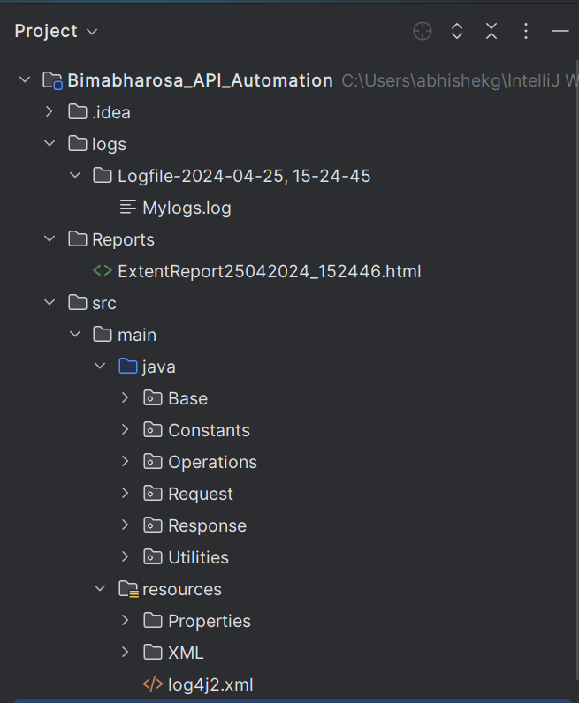
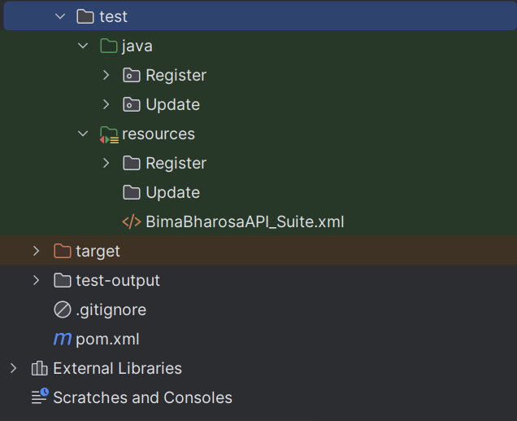
Project File Structure-

Slide 14
Test Case Summary
Modules | TestCases | Positive | Negative | Pass | Fail | Fail Remarks
Register Complaint | 82 | 8 | 74 | 70 | 12 | Script is working fine but there is some bug in functionality
Update Complaint | 85 | 22 | 63 | 77 | 8 | Script is working fine but there is some bug in functionality

Slide 15
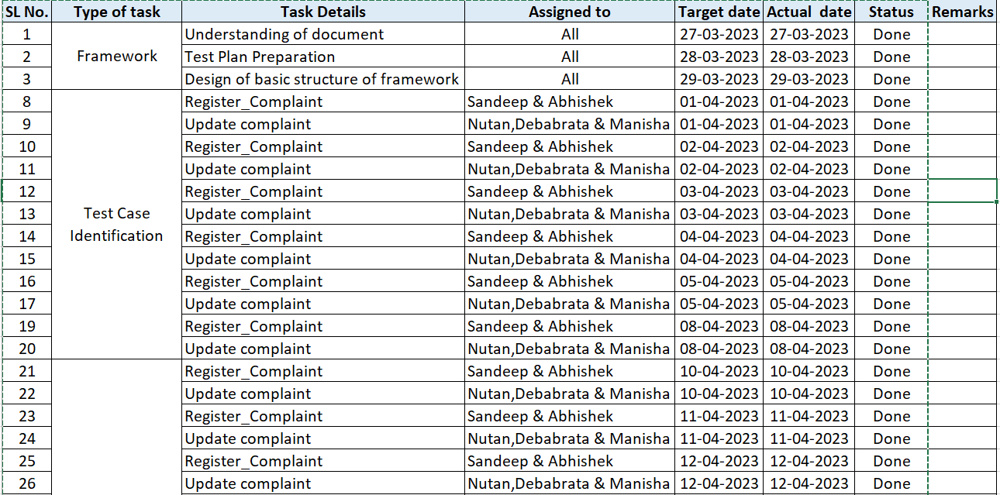
Project Plan

Slide 16
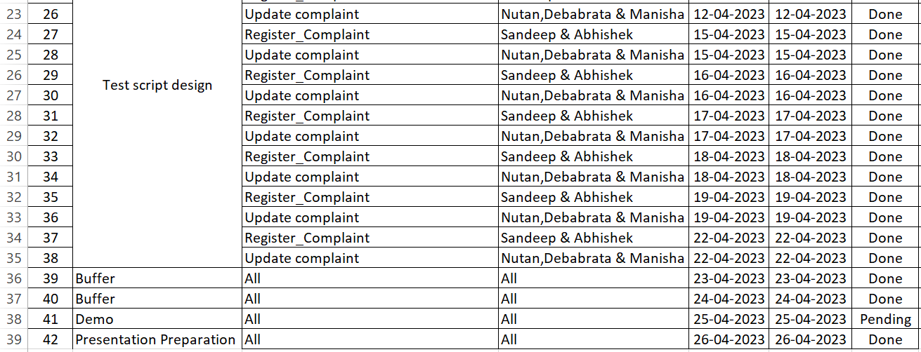
Project Plan

Slide 17
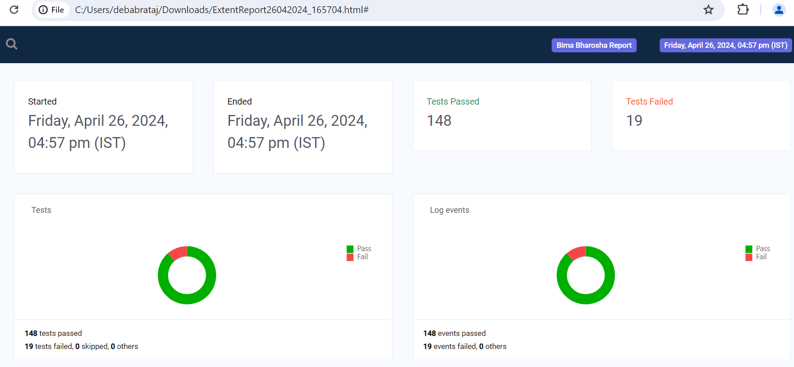
Extent Report-Pie Chart

Slide 18
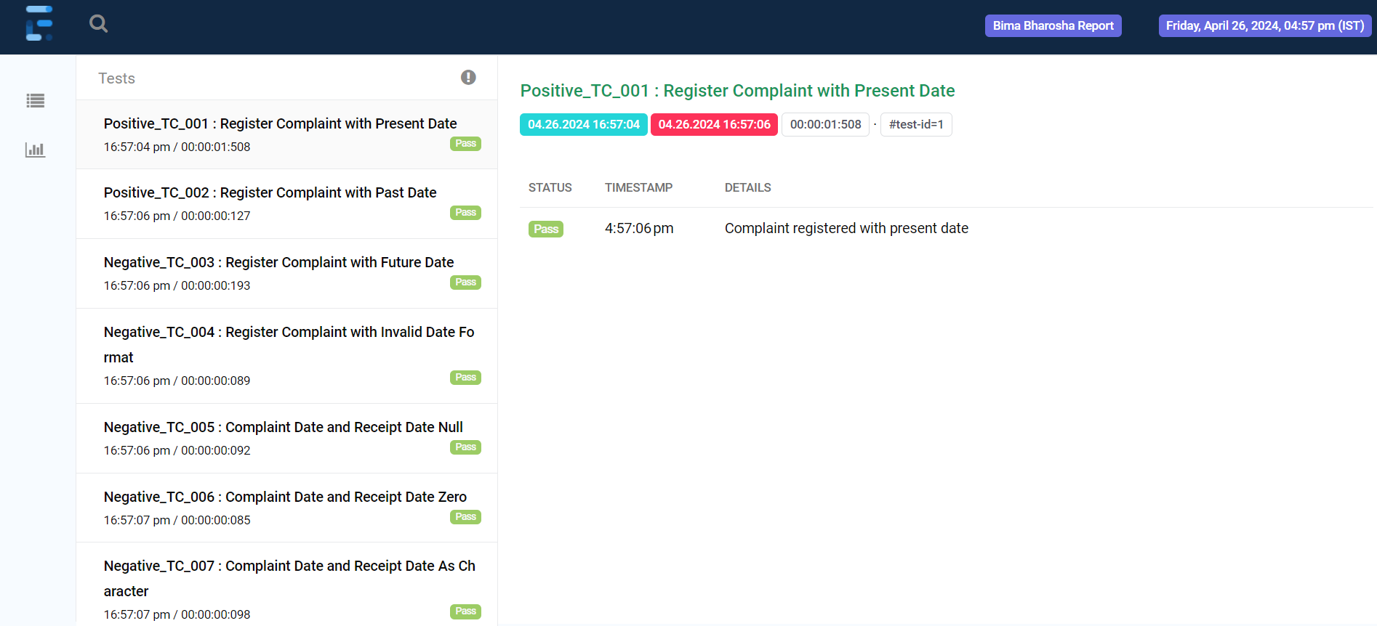
Extent Report-Test Case Status

Slide 19
Future Scope
Mail configuration in framework.
Storing error codes and other codes with descriptions in local DB.
Would use Jenkins for Continuous integration.

Slide 20
Thank you!

